Slide 1
Travel Time Prediction Using Ridge and Lasso Regression

Slide 2
Problem Statement
Travel time varies depending on:
Distance between locations
Pickup and drop-off coordinates
Time of travel
Day of the week
Weekend/weekday patterns
Traditional estimation methods may not provide a consistent prediction.

Slide 3
Proposed Solution
Develop a machine-learning system that:
Accepts pickup and drop-off locations
Calculates route distance
Uses historical trip data
Predicts travel time using Ridge Regression
Predicts travel time using Lasso Regression
Compares both models and recommends the better model

Slide 4
Proposed Solution
Develop a machine-learning system that:
Accepts pickup and drop-off locations
Calculates route distance
Uses historical trip data
Predicts travel time using Ridge Regression
Predicts travel time using Lasso Regression
Compares both models and recommends the better model

Slide 5
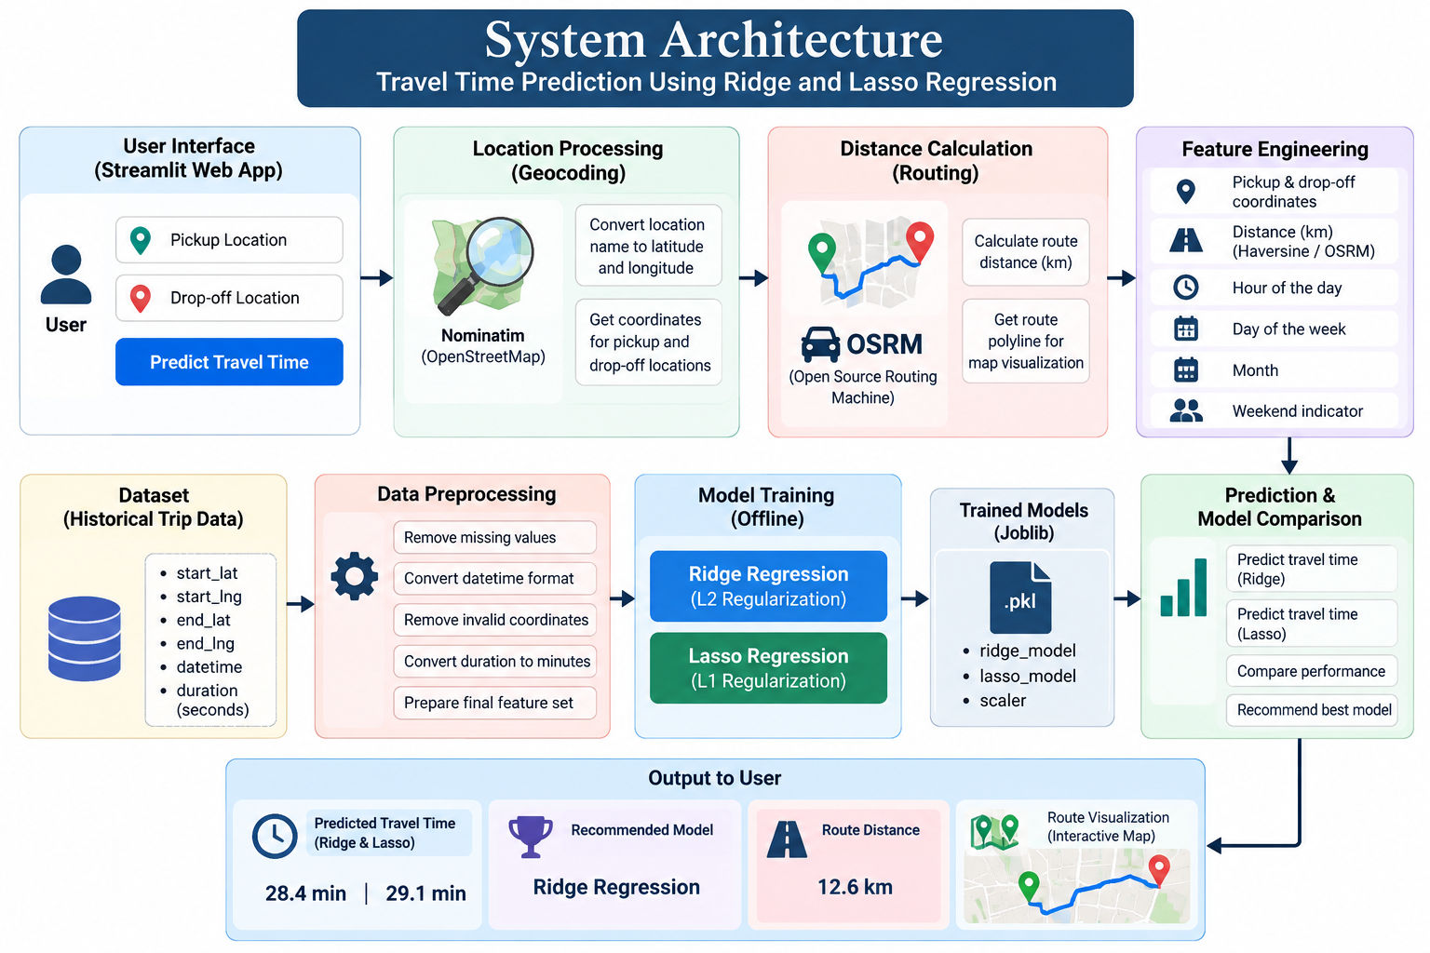

Slide 6
Dataset & Preprocessing
Dataset
Approximately 146K historical trip records
Pickup and drop-off coordinates
Date and time
Trip duration
Preprocessing
Removed missing values
Removed invalid coordinates
Converted duration into minutes
Extracted time-based features
Calculated geographical distance
Feature Engineering
Distance in km
Hour
Day of week
Month
Weekend indicator

Slide 7
Model Building
Ridge Regression
Uses L2 regularization
Reduces coefficient magnitude
Helps control overfitting
Lasso Regression
Uses L1 regularization
Can reduce less-important feature coefficients
Helps with feature selection

Slide 8
Results & Model Comparison
Metric | Ridge Regression | Lasso Regression
MAE | Lower error | Slightly higher error
MSE | Lower error | Slightly higher error
RMSE | Lower error | Slightly higher error
R² Score | Higher | Lower

Slide 9
Thank you

